Slide 1


SMART UNIVERSITY IDENTITY RECOGNITION SYSTEM
Presented by MARYAM FAGBO

Slide 2

INTRODUCTION
I am introducing an innovative implementation of Smart University Identity Recognition System utilizing the power of Computer vision and Machine learning. The system is capable of automatically recognizing the university members using their facial images. It shows how the university identity verification can be implemented by using AI techniques.

Slide 3

MOTIVATION
Several institutions like our University still use manual identification procedures like checking ID cards or matching faces visually. Such procedures are often slow, ineffective, and susceptible to mistakes, but may need to be replaced by systems that can minimize the problem.

Slide 4

PROBLEM STATEMENT
The critical problem is that there is no robust automatic system for identity recognition in campus environments. Every manual system adds to the workload of lecturers and provides at hand opportunities for impersonation.

Slide 5
OBJECTIVE
The goal is to develop and test a system that is capable of identifying people from images of their faces. The system is required to work as accurately as possible, but also to be as fast as possible. Also the task is to see how feasible it is to implement an identification system like this in university environments.

Slide 6

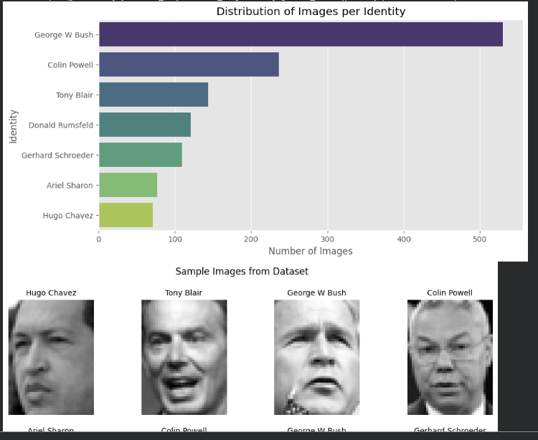
DATASET
This Labeled Faces in the Wild dataset, is one of the most common face recognition datasets. It contains images of many people, with different lighting, poses, and expressions. A filtered set of 7 identities was used to create a stable and balanced training set.

Slide 7
SYSTEM PIPELINE
FEATURE EXTRACTION
The System is developed following the pipeline of data loading and pre-preprocessing, feature extraction, model training & model assessment.
PCA was applied to extract the most significant facial features and reduce dimensionality. It is a technique to dimension the image set (images are turned into a eigen-face). PCA can simplify the data set and take out the noise.

Slide 8

MODELS
This project is an apples-to-apples comparison between classical and deep learning. Classical machine learning models like KNN and SVM are compared with deep learning on the CNN. It allows performance comparisons of all the techniques.

Slide 9

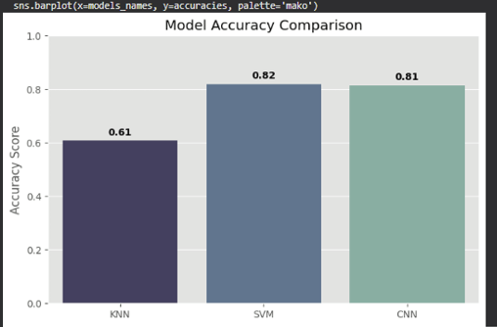
RESULTS
It's clear from the results that accuracy of both SVM and CNN is approximately 81%. KNN performed very poorly due to being very sensitive to curse of dimensionality! It shows that choosing right model to the problem is very important.

Slide 10
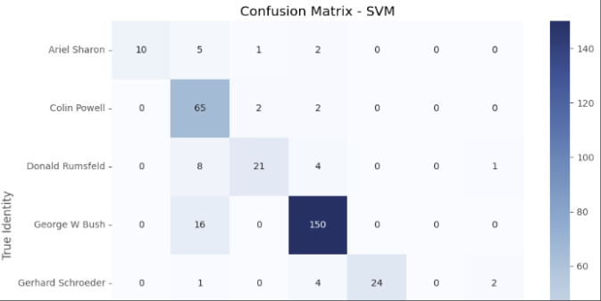
BEST MODEL
The SVM with PCA were selected to be the best model. It gave good accuracy with less computing power than CNN. That makes it more realistic to use for university system in the real life.

Slide 11

LIMITATIONS
This system is also limited by the relatively small dataset size which affects generalization to real-world applications; it doesn't include real-time camera based recognition so it's a prototype rather than a complete system. Other variations such as lighting, pose, background... Are not covered.

Slide 12

FUTURE WORK
Future work would involve including real-time face recognition through camera input. It is also possible to interface it with university systems so an automatic identity verification can take place. Having a larger database and incorporating face detection and tracking will also enhance overall performance.

Slide 13

CONCLUSION
This project demonstrates that both classical and deep learning approaches can effectively solve identity recognition problems. The results confirm that SVM with PCA provides a strong balance between accuracy and efficiency. The system also provides a solid foundation for future smart campus applications.
I HOPE TO SEE IT ONE DAY IN OUR UNI !.

Slide 14
THANK
YOU

